Slide 1
Decision Trees and Association Rule Mining
Fernandez, Ryan Austin
Poblete, Clarisse Felicia M.

Slide 2
Outline
Types of Analytics
Predictive Analytics
Descriptive Analytics

Slide 3
Decision Trees

Slide 4
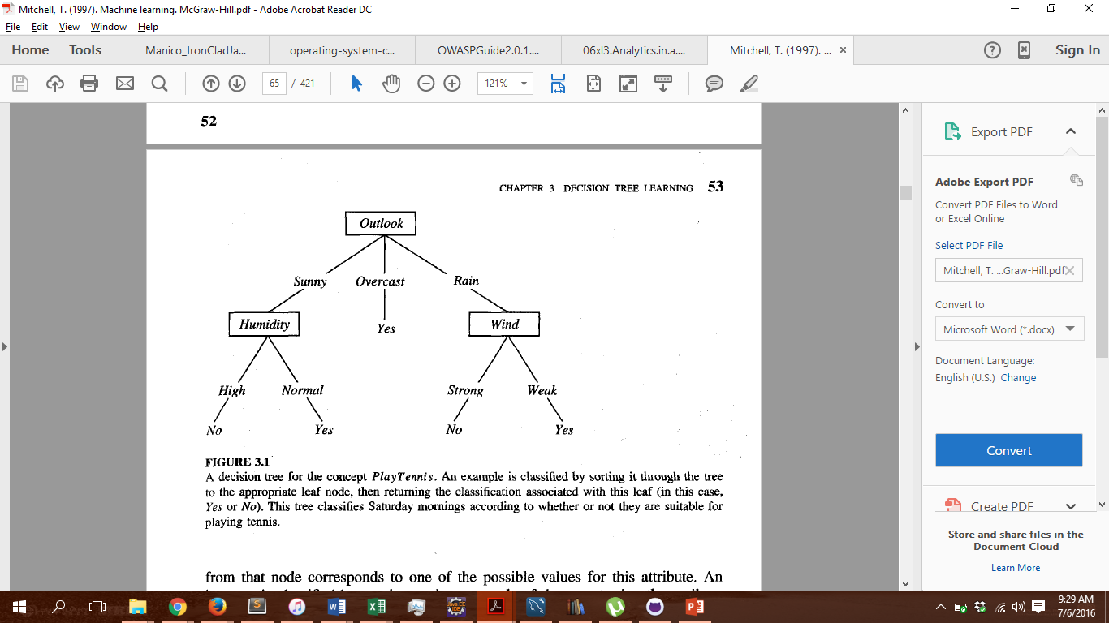
Decision Trees
Approximates discrete valued targets
If-then tree
Nodes => attributes
Leaf => values

Slide 5
When to use Decisions trees
Attributes have discrete values (as much as possible)
Target is discrete
Other considerations
Errors in training data
Missing values

Slide 6

ID3 (Iterative Dichotomizer 3)
Invented by Ross Quinlan
Necessary Formulae
Entropy
$entropy\left(S\right)=−p_{+}\log_{2}{p_{+} }+−p_{−}\log_{2}{p_{−} }$
$entropy for multiple target values= \sum_{i=1}^{n}{−p_{i}\log_{2}{p_{i} }}$

Slide 7

ID3 (Iterative Dichotomizer 3)
Gain
$Gain\left(S,A\right)=Entropy\left(S\right)− \sum_{v∈Values(A)}{\frac{\left|S_{v}\right|}{\left|S\right|}Entropy(S_{v})}$

Slide 8
ID3 (Iterative Dichotomizer 3)
ID3(Set,Target,Attributes) returns a DECISION TREE
Root = new node
If all Set[Target] are the same, return Root with value Set[Target]
If Attributes = {}, return Root with most common value of Set[Target]
Otherwise
A <- A in Attributes where Gain(Set,A) is maximized
For each value v of A
Add a new branch to Root where value is v
Set_{v} = cases in Set where A = v
If Set_{v} = {}
branch = new Node(most frequent value of Set[Target])
else branch = ID3(Set_{v},Target,Attributes – {A})

Slide 9
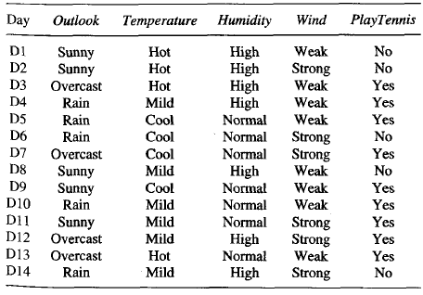

Slide 10
Are target values all the same?

Slide 11
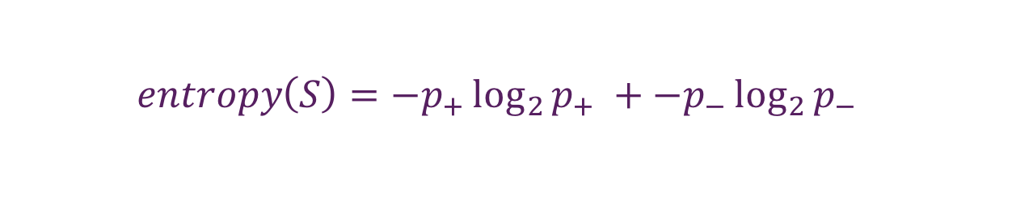
entropy(S)
= – 9/14log₂(9/14)
– 5/14log₂(5/14)
= 0.940
$$entropy\left(S\right)=−p_{+}\log_{2}{p_{+} }+−p_{−}\log_{2}{p_{−} }$$

Slide 12
gain(S, Outlook)
= 0.940 – [5/14 (entropy(Sunny)) +
4/14 (entropy(Overcast)) +
5/14 (entropy(Rain))]
$$Gain\left(S,A\right)=Entropy\left(S\right)− \sum_{v∈Values(A)}{\frac{\left|S_{v}\right|}{\left|S\right|}Entropy(S_{v})}$$

Slide 13
entropy(Sunny)
= – 2/5log₂(2/5)
– 3/5log₂(3/5)
= 0.970
$$entropy\left(S\right)=−p_{+}\log_{2}{p_{+} }+−p_{−}\log_{2}{p_{−} }$$

Slide 14
entropy(Overcast)
= – 4/4log₂(4/4)
– 0/4log₂(0/4)
= 0
$$entropy\left(S\right)=−p_{+}\log_{2}{p_{+} }+−p_{−}\log_{2}{p_{−} }$$

Slide 15
entropy(Rain)
= – 3/5log₂(3/5)
– 2/5log₂(2/5)
= 0.970
$$entropy\left(S\right)=−p_{+}\log_{2}{p_{+} }+−p_{−}\log_{2}{p_{−} }$$

Slide 16
gain(S, Outlook)
= 0.940 – [5/14 (0.970) +
4/14 (0) +
5/14 (0.970)]
= 0.247
$$Gain\left(S,A\right)=Entropy\left(S\right)− \sum_{v∈Values(A)}{\frac{\left|S_{v}\right|}{\left|S\right|}Entropy(S_{v})}$$

Slide 17
Base Case? No
Compute gain
Entropy(S) = -9/14log₂(9/14) – 5/14log₂(5/14)
= 0.940
Gain(S,Outlook) = 0.940 – (5/14(-2/5log₂(2/5)-3/5log₂(3/5)) + 4/14(-4/4log₂(4/4) – 0) + 5/14(-3/5log₂(2/5)-2/5log₂(3/5)))
= 0.940 – (5/14(0.970) + 0 + 5/14(0.970))
= 0.940 – 0.693
= 0.247
Gain(S,Temperature) = 0.940 – (4/14(-2/4log₂(2/4) – 2/4log₂(2/4)) + 6/14(-4/6log₂(4/6)-2/6log₂(2/6)) + 4/14(-3/4log₂(3/4) – 1/4log₂(1/4)))
= 0.940 – (4/14 + 6/14(0.918) + 4/14(0.811))
= 0.940 – 0.911
= 0.029

Slide 18
Gain(S,Humidity) = 0.940 – (7/14(-3/7log₂(3/7)-4/7log₂(4/7))+7/14(-6/7log₂(6/7)-1/7log₂(1/7)))
= 0.940 – (7/14(0.985)+7/14(0.592))
= 0.940 – 0.789
= 0.151
Gain(S,Wind) = 0.940 – (8/14(-6/8log₂(6/8)-2/8log₂(2/8)) + 6/14(-3/6log₂(3/6) – 3/6log₂(3/6)))
= 0.940 – (8/14(0.811) + 6/14)
= 0.940 – 0.892
= 0.048
Max Gain is with Outlook
Split on Outlook

Slide 19
Current Tree
Repeat Algorithm on each branch, considering only temperature, humidity, and wind

Slide 20
ID3 Characteristics
Hill-Climbing Search
Prefers Shorter Trees
Occam’s Razor

Slide 21
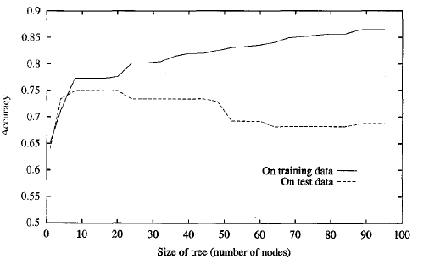
Issues
Overfitting Data

Slide 22
Issues
Continuous Data
Compute Maximum Gain Partition
Optimal Split at (26 + 28 / 2) = 27
Two classes: <= 27 and > 27
Value | 23 | 26 | 28 | 29 | 40 | 50 | 55
Target | Yes | Yes | No | Yes | No | No | Yes
Gain at split | 0.127 | 0.292 | 0.020 | 0.128 | 0.005 | 0.127

Slide 23
Issues
Gain Ratio
Consider Date
Gain = Entropy(S) – 1/n(0) //0 because each date has only one record and thus one value and thus //entropy = 0
Consider SplitInformation(S,A) = Entropy(S) considering A as the target variable
SplitInformation(S,Date) = log₂V(S,Date)
Use GainRatio(S,A) = Gain(S,A) / SplitInformation(S,A)
The more entropy along A, the higher the divisor, the lower the GainRatio

Slide 24
Issues
Missing Values
Two Approaches
Give it the most frequent value
Probabilistic Approach

Slide 25
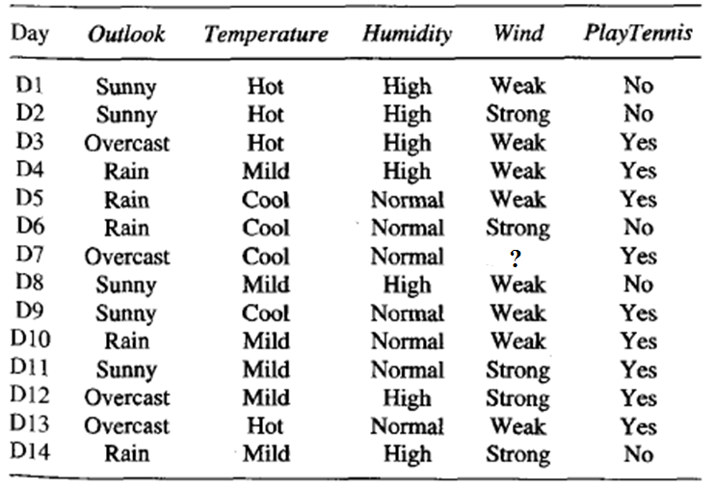
Missing value for Wind
8/13 of known instances are Weak
5/13 are Strong
Approach 1: Assign value Weak
Approach 2: Give Record weight of 8/13 Weak and 5/13 Strong
Gain computation becomes
Gain(S,Wind) = Gain(S,Wind) = 0.940 –
((8 + 8/13)/14(-7/9log₂(7/9)- 2/9log₂(2/9)) +
(5 + 5/13)/14(-3/6log₂(3/6) – 3/6log₂(3/6)))
= 0.940 – (8/14(0.811) + 6/14)
= 0.940 – 0.855
= 0.085

Slide 26

Issues
Cost
Some attributes may cost more to collect
Consider new value $CostGain= \frac{{(Gain\left(S,A\right))}^{2}}{Cost(A)}$
Not flexible
Weighted Formula $CostGain= \frac{2^{Gain\left(S,A\right)}−1}{{(Cost\left(A\right)+1)}^{w}}$
W in interval [0,1] is weight of Cost(A)

Slide 27
C4.5 Algorithm
Very Similar to ID3
Differences
Use GainRatio to choose an Attribute A
Postpruning Rules
Partitioning Continuous Data is supported
Weighted Approach to Missing Valued records

Slide 28
Postpruning
Using DFS, Generate the rules of the tree.
If Outlook = Sunny ^ Humidity = High Then No
If Outlook = Sunny ^ Humidity = Normal Then = Yes
If Outlook = Overcast Then Yes
If Outlook = Rain ^ Wind = Strong Then No
If Outlook = Rain ^ Wind = Weak Then Yes

Slide 29
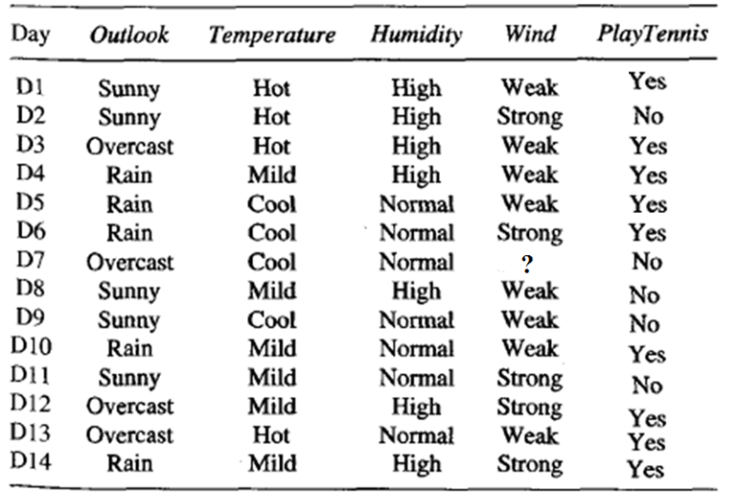

Postpruning
For each rule, evaluate the accuracy using a pessimistic approach.
Let p = accuracy in pruning set of rule r
$$Pessimistic Estimate=p −1.96 ∗ \sqrt{p(1−p)}$$
$\sqrt{p(1−p)}$ is the standard deviation of binomial distribution of rule r being true for any given instance.
If Outlook = Sunny ^ Humidity = High Then No
P.E. = -0.25
If removing a clause in the precondition does not lower accuracy, remove it.

Slide 30
Postpruning
Original Rule
If Outlook = Sunny ^ Humidity = High Then No
P.E. = -0.25
Remove first clause
If Humidity = High Then NO
p = 0.29
P.E. = -0.60 (lower value; reject)
Remove second clause
If Outlook = Sunny Then No
p = 0.8
P.E = 0.016 (higher value; prune second clause in final tree)

Slide 31
Postpruning
Pruning is done to avoid overfitting the data

Slide 32
Association Rule Mining

Slide 33
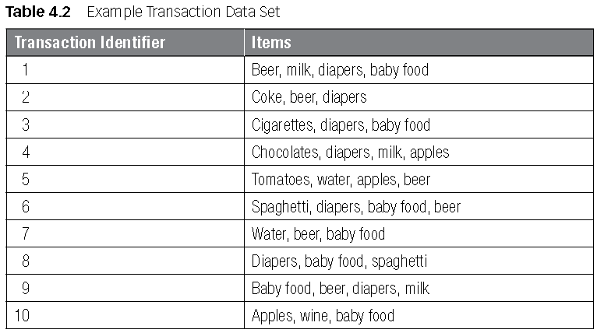

Association Rule Mining
Support(X) =$\frac{Number of Records that contain X}{Number of Records}$
Support(Beer) = 6/10 = 0.6
Support(Water) = 2/10 = 0.2
Support(Beer U Water) = 2/10 = 0.2
Confidence(X->Y)
= $P\left(Y | X\right)= \frac{Support(X U Y)}{Support(X)}$
Confidence(Beer->Water)
= 0.2/0.6 = 0.33
Confidence(Water->Beer)
= 0.2/0.2 = 1.0

Slide 34
The Algorithm
Set a minimum support minsup and a minimum confidence minconf
Find all subsets above minsup
For each subset k, find all nonempty subsets s
Output all rules s -> k – s above minconf

Slide 35

A Priori Algorithm
$∀s∈sets∀k∈P\left(s\right)\left(Support\left(s\right)≥minsup →Support\left(k\right)≥Minsup\right)$
Contrapositive
$∀s∈sets∀k∈P\left(s\right)\left(Support\left(k\right)<minsup →Support\left(s\right)<Minsup\right)$
If a set does not meet minsup, all supersets do not meet minsup
The Algorithm
Find all sets of cardinality above 1
Keep considering supersets of the chosen sets

Slide 36
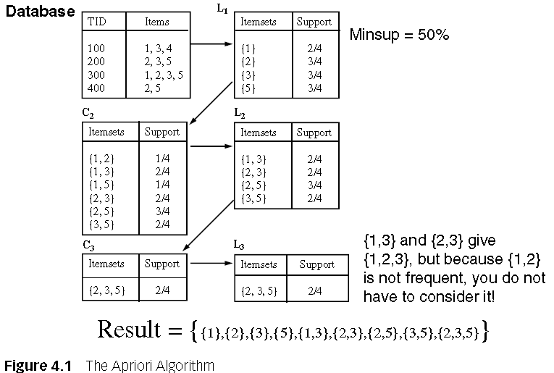

Slide 37
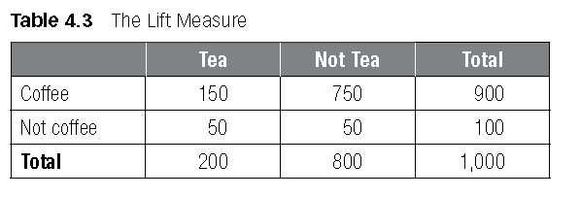
Lift Measure
Choose a random person. What is the Support(coffee)? 90% = 0.9
Support(tea)? 20% = 0.2
Support(tea U coffee)? 15% = 0.15
Confidence(tea->coffee) = 0.15/0.2 = 0.75 = 75%
But… what is the chance of buying coffee?
90% right?
Better to just guess

Slide 38

Lift Measure
$Lift\left(X→Y\right)= \frac{Support(X U Y)}{Support\left(X\right)∗Support(Y)}= \frac{Confidence(X→Y)}{Support(Y)}$
If Lift > 1, the rule is interesting enough (more interesting than a blind guess)

Slide 39
Postprocessing
Filter out trivial rules
Help from Business Expert
Sensitivity Analysis
Play with minsup and minconf

Slide 40
Conclusion

Slide 41
Conclusion
Decision Trees used for predicting discrete values
Association Rules used for describing common patterns in data

Slide 42
References
Baesens, B. (2014). Analytics in a Big Data World: The Essential Guide to Data Science and its
Applications. NJ: John Wiley & Sons.
C4.5 Algorithm. (n.d.). Retrieved July 6, 2016, In Wikipedia: https://en.wikipedia.org/wiki
/C4.5_algorithm
Hssina, B., Merbouha, A. et al. (n.d.) A comparative study of decision tree ID3 and C4.5. Sultan Moulay
Slimane University.
Mitchell, T. (1997). Machine Learning. McGraw Hill.

Slide 43
Demo
http://tinyurl.com/id3arm

